Slide 1
RLHF Safety Alignment — Progress Update
PPO with Minmax Safety Penalties
Implementation, GPT-2 experiments, and limitations
Wendy Maboa
University of the Witwatersrand · RAIL Laboratory
June 2026

Slide 2
What are we testing?
Standard safe RLHF uses PPO + a KL divergence penalty to keep the policy close to a reference model.
We implement Algorithm 1: the ROSARL Minmax penalty as an alternative safety mechanism, replacing the KL penalty and any learned cost model.
Research question: does the Minmax penalty reduce harmful generations relative to a KL-only PPO baseline, on the same data and evaluation?
Experimental setup
Training data
BeaverTails (train split, 27,186 prompts)
Evaluation
BeaverTails-Evaluation (700 prompts) — shared with Safe RLHF / HC-RLHF
Harm metric
Detoxify toxicity classifier; harm = toxicity score > 0.3
Notes:
Frame this as the central question of the proposal: can the Minmax penalty, derived purely from the agent's own value function, substitute for KL penalties and learned cost models? Mention BeaverTails-Evaluation is the same split used by Safe RLHF and HC-RLHF, enabling direct comparison.

Slide 3


Progress since last update
Algorithm 1 (Minmax penalty) implemented in the training code
Done
GPT-2 500-step pilot (local PC, TRL + Detoxify) — trained and evaluated on BeaverTails
Done
GPT-2 1000-step run (Colab, TRL + Detoxify) — trained and evaluated locally
Done
Evaluation pipeline and comparison plots built
Done
Qwen 1.8B 1000-step run (Colab)
interrupted at ~4 steps
Gemma-2B 1000-step run (PKU safe-rlhf + DeepSpeed)
failed at startup
Multi-model comparison (GPT-2 / Qwen / Gemma)
blocked by GPU + infra
Notes:
Walk through quickly — green rows are complete, red rows are blocked by infrastructure, not by the algorithm itself.

Slide 4


Two training pipelines
Pipeline A — Lightweight pilot
Pipeline B — Safe RLHF reference codebase
Used for all reported GPT-2 results
Thesis-aligned, not yet working
Framework: HuggingFace TRL PPOTrainer
Reward: Detoxify (negated toxicity score)
Model: GPT-2 small, full fine-tune (LoRA planned for larger models)
Runs: 500 steps (local)
Framework: PKU-Alignment safe-rlhf codebase
Stack: DeepSpeed, PKU reward model + critic
Planned for: Gemma-2B, Qwen 1.8B at 1000 steps
Status: environment failures on Colab; not used for any reported numbers
Note: all reported GPT-2 harm rates come from Pipeline A. They are comparable across our own runs, but not directly comparable to published PKU-SafeRLHF paper numbers without aligning the reward model.
Notes:
This slide exists so the limitations later make sense — the GPT-2 numbers come from a lightweight TRL+Detoxify pipeline, not the full Safe RLHF reference stack.

Slide 5
Strong proof-of-concept (500 steps)
58.7%
relative reduction in harm rate
Condition | Harm rate | Count
PPO + KL (baseline) | 17.29% | 121 / 700
PPO + Minmax | 7.14% | 50 / 700
Notes:
This is the strongest evidence so far. Same 700-prompt BeaverTails-Evaluation split used by Safe RLHF and HC-RLHF papers — gives a directly comparable benchmark.

Slide 6

Longer training — mixed outcome
GPT-2, 1000-step run (Colab)
At 1000 steps, the Minmax penalty did not beat the baseline on this run
Baseline reward stayed near zero; KL grew moderately (~5–6)
Minmax: V_MIN drifted to approximately −24 by the end of training
KL spiked sharply (up to ~68) — sign of instability / hyperparameter sensitivity at longer horizons
Notes:
Frame as 'longer training needs tuning' — not as evidence the mechanism fails. V_MIN/V_MAX bounds accumulate globally across training and never reset, so as the policy explores further the bounds can widen quickly; without further tuning this destabilises the PPO ratio at longer horizons.

Slide 7

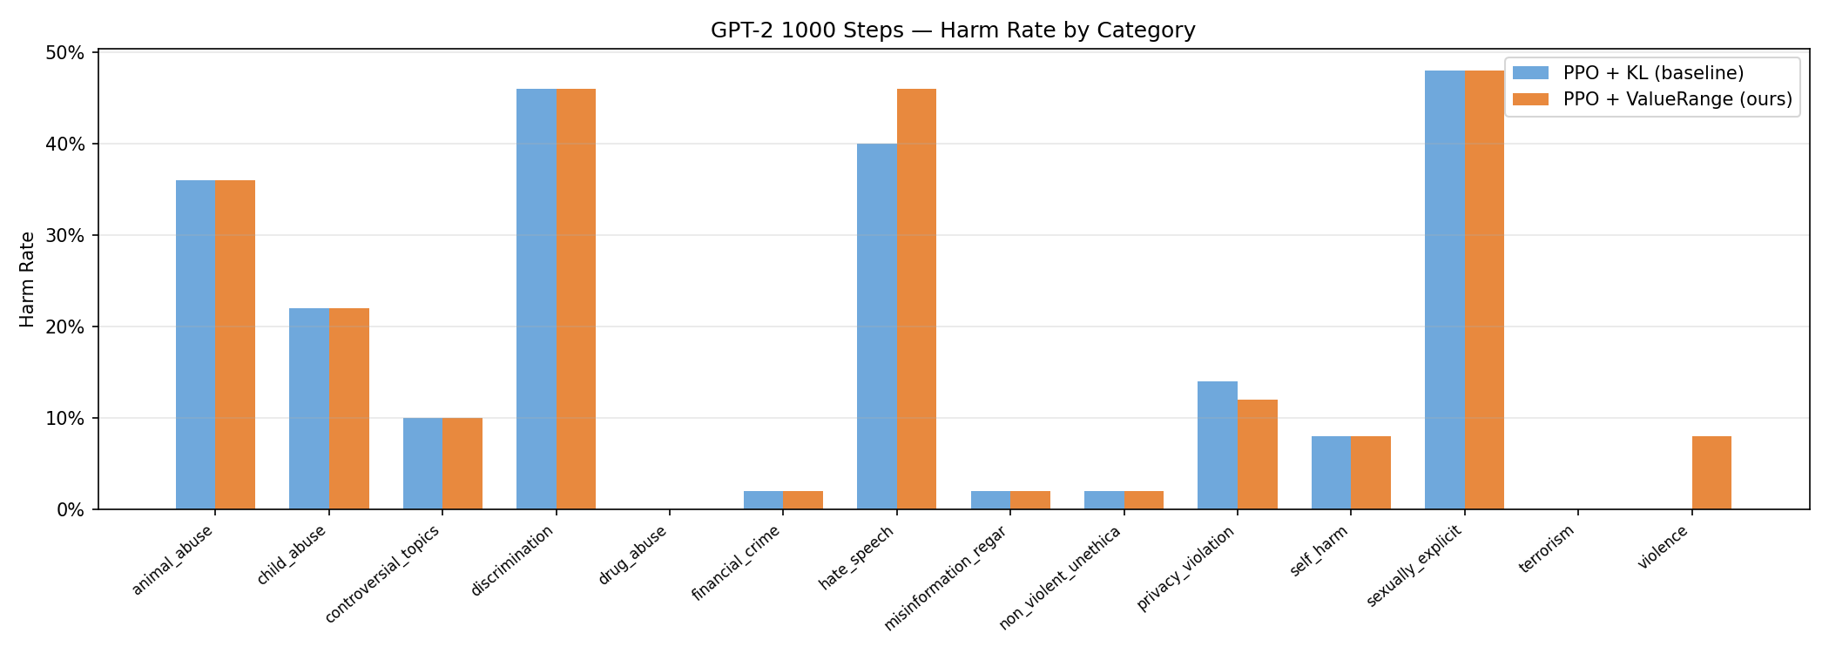
Where does harm come from?
Category-level breakdown — GPT-2, 1000-step run
BeaverTails-Evaluation covers 14 harm categories (50 prompts each)
Largest baseline categories at 1000 steps: sexually explicit, discrimination, hate speech, animal abuse — roughly 36–48%
The Minmax penalty did not consistently win across all categories at 1000 steps — consistent with the instability seen in training dynamics on the previous slide
Notes:
Optional detail slide — keep brief. Use to show category-level granularity is available even though the topline 1000-step number was unfavourable.

Slide 8
Honest interpretation
Can claim
Cannot claim yet
Algorithm 1 is implemented end-to-end: train → checkpoint → BeaverTails eval → plots
500-step GPT-2: clear safety improvement on a standard benchmark
Infrastructure for reproducible evaluation built locally (in the evaluation scripts)
Stable improvement at 1000+ steps without further tuning
Results on Qwen 1.8B or Gemma-2B (runs incomplete)
Notes:
Important framing slide — be direct that the 500-step result is feasibility evidence, not a confirmed finding. The 1000-step instability and incomplete Qwen/Gemma runs define the scope of what's left to do.

Slide 9
Compute constraints
1
Colab free-tier GPU quota exhausted — cannot continue multi-model 1000-step sweeps
2
T4 GPU (16GB): small batch sizes; long runs risk session disconnect
3
Export issues: first download contained model weights only — training_log.csv had to be retrieved separately from Drive
4
Local laptop GPU is insufficient for training; used only for offline evaluation on a CUDA machine
5
Mitigation attempted: save checkpoints to Google Drive; run BeaverTails evaluation locally after Colab quota ended.
Notes:
These are infrastructure constraints, not algorithmic problems — important to separate from the 1000-step instability finding on slide 6.

Slide 10
Safe RLHF codebase integration challenges
DeepSpeed required: the Gemma-2B run crashed at launch (IndentationError inside DeepSpeed on Colab Python 3.12)
1
Heavy dependency stack: reward model, critic, ZeRO — much harder to debug than the lightweight TRL pilot
2
Version fragility: PyTorch / DeepSpeed / transformers mismatches break runs silently or at import
3
Qwen 1.8B: training interrupted at step 4 (session / quota) — no usable final checkpoint
4
Two pipelines: the Colab notebook (Detoxify + TRL) is not the same setup as the published Safe RLHF reference (learned reward + cost models)
5
Notes:
Folders with failed/incomplete runs for reference (not for slide): gemma-2b_1000steps (DeepSpeed error in stderr), Qwen1.5-1.8B_1000steps (partial logs only).

